Slide 1
CS 0447 Recitation 11

Slide 2
Last Week’s Quiz
Q1
A: Context switches are slower
When context switching from user to kernel mode, registers must be saved. The more registers to save, the slower the context switch will be
Q2.1
A: Because there are 32 registers in the register file
We need 5 bits to represent 32 unique numbers, so 5 bits is enough to address all 32 registers.
Notes:
Q1: Which of the following is a major drawback to including lots of registers in a CPU?
Q2: Imagine there is a register file where ReadRegister1, ReadRegister2, and WriteRegister inputs are 5 bits wide. Also, WriteData, ReadData1 and ReadData2 ports are 32 bits wide In the Register File, why is ReadRegister1, ReadRegister2, WriteRegister 5 bits wide?

Slide 3
Last Week’s Quiz
Q2.2
A: Because the registers can hold 32 bits of data each
Each register holds 32 bits of data, so that is how many bits we need to write/read the registers.
Q3
A: Priority Encoder
This is basically the definition of an encoder – it returns the index of the input whose value is 1
Notes:
Q2.2: In the same register File, why is WriteData, ReadData1, ReadData2 32 bits wide?
Q3: What Logism component accepts several 1-bit inputs and outputs the index of the input with the value of 1?

Slide 4
This Week’s Quiz
You know the drill

Slide 5
Project 3
Project 3 was posted right before break
You’ll be making a CPU in Logisim!
As always, you should start this early
Also: debugging circuits can be challenging – please use tunnels and make your circuit as “clean” as possible

Slide 6
Project 3 - µMIPS
You’ll be implementing a simplified version of MIPS
Its native word size is 16 bits, it has 8 registers, and it has separate instruction and data memory
See the project description for the instructions that need to be supported and their format
It is a single-cycle CPU – in one clock cycle, an instruction will be fetched and executed

Slide 7
Project 3 - Components
You, broadly, will need several components:
Register file
Data memory
Instruction memory
ALU
Etc.
They’re all listed under “project requirements” in the project description. The project description also goes into detail on the implementation of these components
You can use any component that you find in Logisim’s libraries – please don’t try to implement your own adders

Slide 8
Project 3 - Misc
There is an assembler available for download that will assemble example programs into machine code for your CPU
Or you can download the pre-assembled versions
The autograder expects you to follow the project description – your CPU should follow the specification given
There is a chart detailing the order in which you should implement your instructions for the autograder to work properly

Slide 9
Project 3 – General Tips
Please start early
Plan ahead! This project is like writing a program – you should have an idea of what you will do before you do it
Test as you go! Write simple test programs and assemble them to make sure your CPU works correctly
Use subcircuits – in the same way that all of a Java program does not go in main, all of your circuitry should not be in the same file
Define subcircuits then instantiate them
Follow the conventions detailed towards the end of the project description

Slide 10
Instruction Execution Phases
Fetch
Grab the next instruction from memory – this is stored in PC
Decode
Look at the instruction and set the appropriate control signals
Execute
Wait for data to flow through our datapath
Memory Access
If the instruction is a load or a store, do that
Write-back
If there is a destination register, write the result there

Slide 11
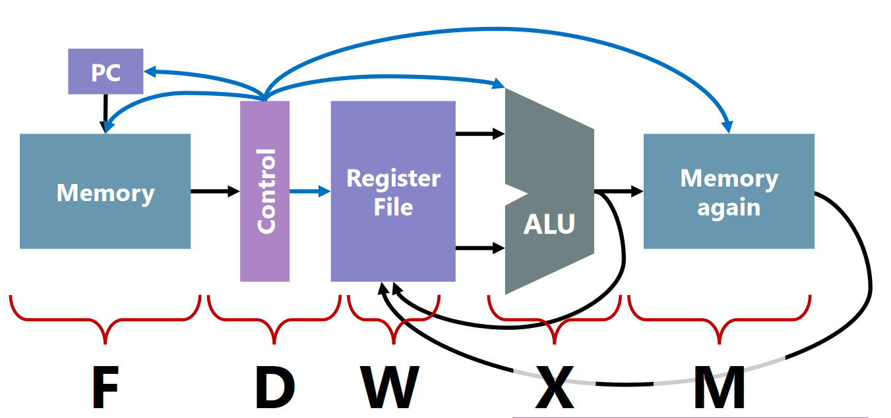
Phases visualized

Slide 12
Structural Hazards
Lets say we want to lw t0, (s0)
We can’t read two memory locations at once! We need to grab the instruction and the value stored at s0
Two approaches to solving this problem:
Harvard Architecture: Have two memories – one for instructions and one for data
Von Neumann Architecture: Have one memory and use multiple cycles to read from 2 locations
Von Neumann machines are the most common by far

Slide 13
The Interconnect
We need to connect all the pieces of our CPU!
We can look at the instructions we need to support (the ISA) to get an idea of how components need to be connected
For example – to support subtraction the register file needs to plug into the ALU
If a component has multiple things connected to its input, we need a MUX!
Remember that a MUX makes choices – we want to choose which input to select

Slide 14
The Control
The control is what sets the various signals in the CPU
It reads instruction and tells other components what to do
There are two kinds of control signals
Selects – They go into the select pins of muxes, demuxes, and decoders – they tell those components what choice to make
Write enables – These tell registers and memory when to store data
Nearly every instruction writes to somewhere
If it doesn’t it’s a no-op because nothing really happened

Slide 15
Instruction Decoding
First step – split the encoded instruction up
Instructions are bitfields – so we just need to grab the relevant sections of the bitfield
We might have different types of instructions whose bitfields have different meanings, but that doesn’t matter
We can just ignore the values that are invalid for a given instruction type
What type of gate should we use for decoding? How about a decoder!
Exactly one output pin will be set to 1 for a given input
So all we need to do is come up with the logic for each control signal

Slide 16
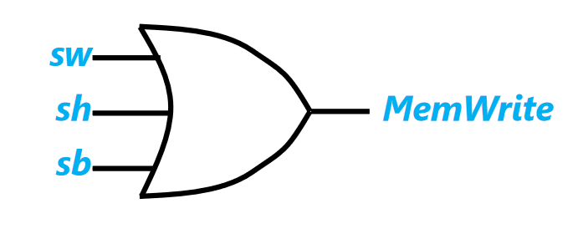
Instruction Decoding Example
We want to implement the MemWrite control signal
It tells us when we should write to memory
Which instructions write to memory?
sw, sh, sb
We can use an OR gate!

Slide 17
Multi-Bit Control Signals
We can use priority encoders
These take several 1-bit inputs, and tell us which one is 1
For example, let’s say we want to implement the ALU control signal
We ask ourselves: which instructions need this ALU operation?
Those instruction signals should OR’d together in the input to the encoder that corresponds to that ALU operation
Example: If ALU op 2 adds, all instructions that need to add should be hooked up to input 2 of the encoder

Slide 18
Single Cycle CPUs
So far we have discussed single-cycle CPUs – each instruction takes one clock cycle to execute
Critical path – the longest path through the circuit that requires sequential operations
The critical path limits our clock speed
The above is a big issue for single-cycle CPUs! Why?
Memory is S L O W
This means that our clock speed is bound by how long loads/stores take
So the faster instructions run slower than they could because loads/stores are so slow

Slide 19
Lab 11 Part A
This Lab is intended to get you started on Project 3, much like Lab 7 and Project 2
There are very detailed instructions in the lab description – follow along with these to implement your mini CPU

Slide 20
Lab 11 Part B
Again, there are pretty detailed hints in the lab description
Your task is to write all values from 0x0 to 0xf to memory, and then stop
You’ll need to detect when the counter hits 0xf
You’ll need to stop writing to memory once that happens

